Slide 1
Out of Mind, Insight serotonergic psychedelics & schizophrenia
Jason Gale

Slide 2
Today’s Topics
Schizophrenia
psychotic disorder
Hallucinations
visual
Visual System
visual cortex

Slide 3
Let’s explore…
Since serotonergic psychedelics cause visual hallucinations…
How do they affect the brain / visual system?
Does the administration of serotonergic psychedelics cause changes similar to those experienced in schizophrenia?
Could psychedelics be used to test schizophrenia treatments?
How do psychedelics’ effects relate to perceptual changes?
Notes:
“they” – psychedelics

Slide 4
Schizophrenia
dementia praecox - “very early losing of one’s mind”
onset – adulthood
1% lifetime prevalence
psychotic disorder
psychosis – loss of contact with reality
brief psychotic, schizophreniform, schizoaffective, delusional, shared psychotic
Notes:
brief psychotic disorder
any psychotic symptom between 1d-1mo
probably after a strong psychosocial stressor – death or birth
schizophreniform disorder
same as schizophrenia except 1mo-6mo
and may be able to conduct daily activities
schizoaffective disorder
schizophrenia + depression/mania/mixed
controversial diagnosis
delusional disorder
having nonbizarre delusion
possible event
maybe a hallucination about the delusion
shared psychotic disorder
two or more people share a delusion
one person starts with a delusion, passes it to another
blood/marriage/close proximity

Slide 5
Schizophrenia Symptoms
Loss of brain function
learning and memory
attention
comprehension
abstract reasoning
solve problems
make decisions
Notes:
declines/decreases/slows each of these cognitive abilities

Slide 6
Schizophrenia Symptoms
Negative symptoms – absence
Emotional Expression – face & voice
Anhedonia – pleasure
Avolition/apathy – interest
Alogia – speech
Psychomotor Slowing – thoughtful movements
Notes:
negative symptoms – absence of a normal behavior/feeling

Slide 7
Schizophrenia Symptoms
Positive symptoms – presence
Disorganized thinking – abnormal speech
derailment – off-topic; double-meanings
thought blocking – long pauses
clanging – similar-sounding words
Abnormal motor behavior
catatonia – awake but unresponsive
waxy flexibility – moldable
Notes:
positive symptoms – presence of abnormality

Slide 8
Schizophrenia Symptoms
Positive symptoms – presence
Delusions – false thoughts/beliefs
influence – outside control
self-significance – importance of objects & actions
persecution/paranoia – outside harm
somatic – rotting body
Notes:
positive symptoms – presence of abnormality

Slide 9
Schizophrenia Symptoms
Positive – presence
Hallucinations – false perceptions
auditory – sounds/voices
tactile/somatic – physical sensations
visual – visions
olfactory – smells
gustatory – tastes
Notes:
positive symptoms – presence of abnormality

Slide 10
Schizophrenia & Serotonin
Complex & contradictory
Similar alterations as psychedelics
Postmortem studies
5-HT_{1A} receptors
increased densities in prefrontal cortex (PFC)…
5-HT_{2A} receptors
decreased densities in PFC
because of treatment effects?

Slide 11
Pharmacological Treatments for Schizophrenia
Classical (typical) antipsychotics
e.g. haloperidol (HAL)
reduce positive symptoms
block dopamine receptors (D₂)
serious side effects more likely
tardive dyskinesia – involuntary/abnormal movements

Slide 12
Pharmacological Treatments for Schizophrenia
Atypical antipsychotics
e.g. risperidone (RIS)
reduce positive symptoms – and some negative and cognitive
block D₂ & block 5-HT_{2A(& 2C)}
serious side effects less likely

Slide 13
Psychosis & Psychedelics
compared using assessments of ASC
altered states of consciousness
three elements of ASC
oceanic boundlessness – positive feelings
awe, selflessness, togetherness
dread of ego-dissolution – negative feelings
loss of control, paranoia, catatonia
visual restructuralization

Slide 14
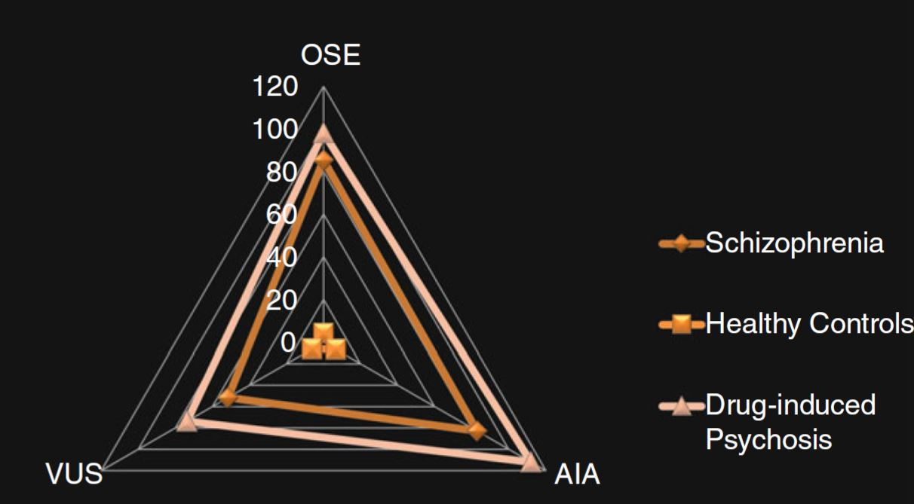
Visual Restructualization (VUS)
oceanic boundlessness
changes in perceptual interpretations
synesthesia – sense-mixing
illusions
visual hallucinations
ego-dissolution

Slide 15
Hallucinations
Schizophrenia
Auditory > Visual
But, acute & initial stages – ↑Visual
Serotonergic Psychedelics
Auditory < Visual
5-HT_{2A} action
mouse head-twitch response (HTR)
Prefrontal Cortex (PFC) – activity
PFC-MD (mediodorsal thalamus) connections
Notes:
first-episode, and acute schizophrenia typically has more visual hallucinations than later episodes, and chronic schizophrenia
PFC activity related to hallucinations

Slide 16
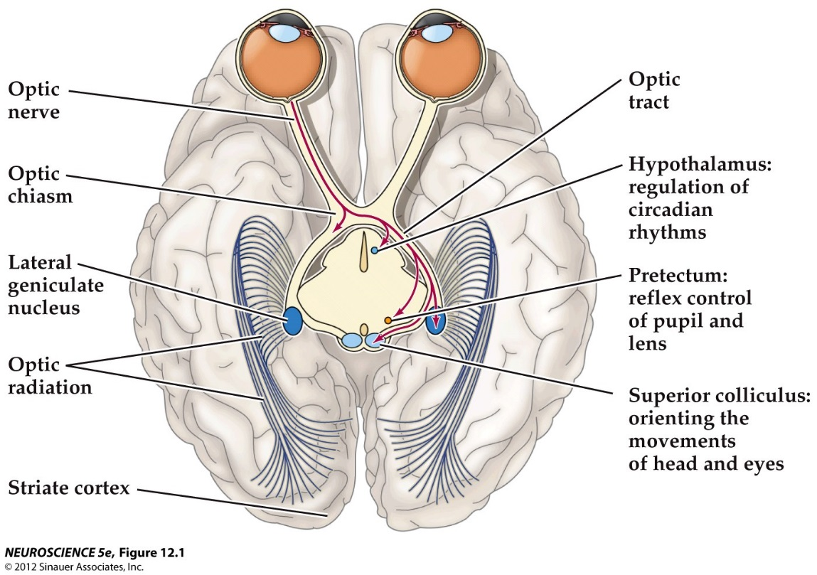
Visual System
Eye (retina) →
lateral geniculate nucleus (LGN) →
striate (visual) cortex (V1)

Slide 17
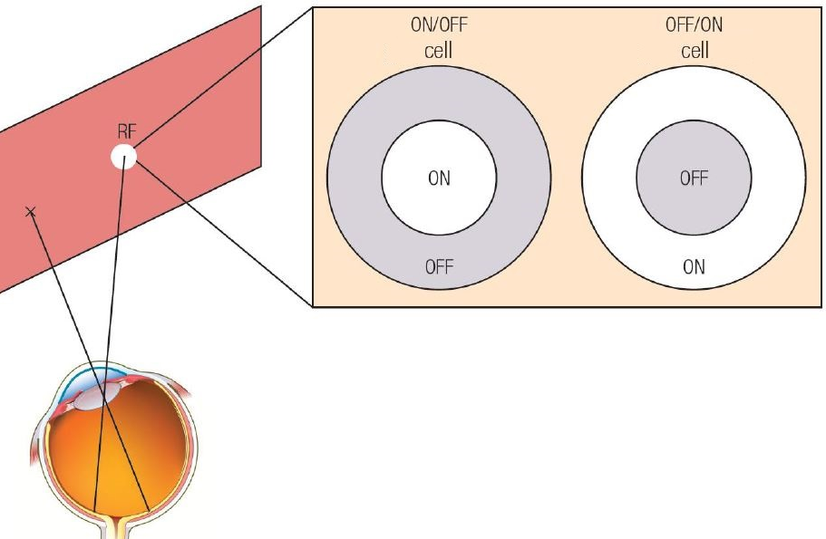
Visual System: Receptive Fields (RF)
Represent firing pattern of corresponding cells in the visual system
ON/OFF = On-center/Off-surround
OFF/ON = Off-center/On-surround

Slide 18
Visual System: Receptive Fields
Images in the “On” portion
Drive (increase) firing rate (FR)
Images in the “Off” portion
Suppress (decrease) firing rate
This example: center-driving, surround-suppressing
classical receptive field (CRF)
center
extra-CRF
surround

Slide 19
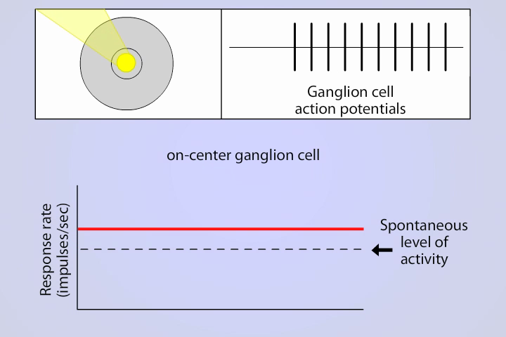
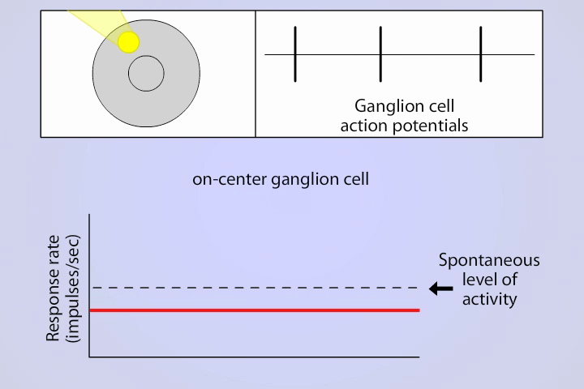
Visual System: Receptive Fields
On-center = Center-driving & Surround-suppressing

Slide 20
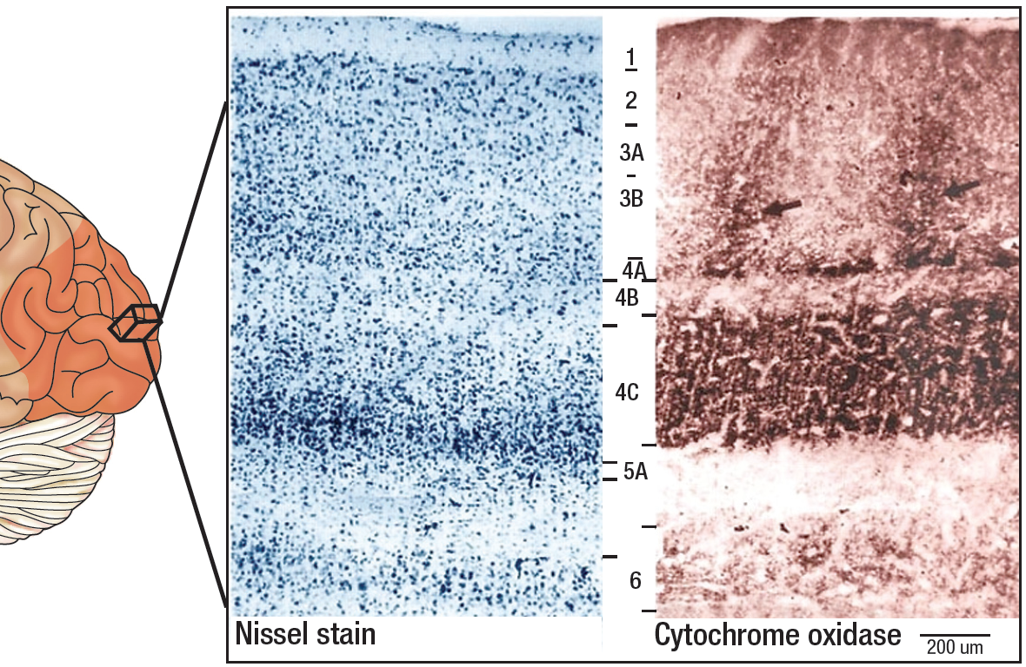
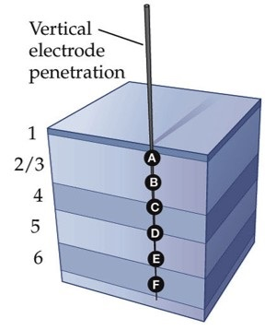
Visual System: Cortex Layers
V1 into layers
by size
by density
cells aligned across layers
same receptive fields

Slide 21
Visual System: Retinotopic Maps
Match stimuli in visual field to active cells in the visual pathway

Slide 22
Hypotheses
If hallucinogenic behaviors in mice are related to those in humans…
Mouse and human behavior will change similarly in response to changes in psychedelic potency
Since hallucinations are not representative of the external world…
Areas that respond to external stimuli are less active
If psychedelics’ effects are similar to schizophrenia’s…
Hallucinogenic behavior will be prevented by antipsychotics

Slide 23
Hallucinogenic Behavior
hallucinogenic 5-HT_{2A} activation
Mice
head-twitch response (HTR)
potency – ED₅₀
median effective dose
Humans
subjective experience
Notes:
HTR won’t happen with non-hallucinogenic 5-HT_{2A} agonism

Slide 24
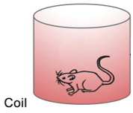
Head-twitch response
measured electronically
by magnetometer and magnet on head

Slide 25
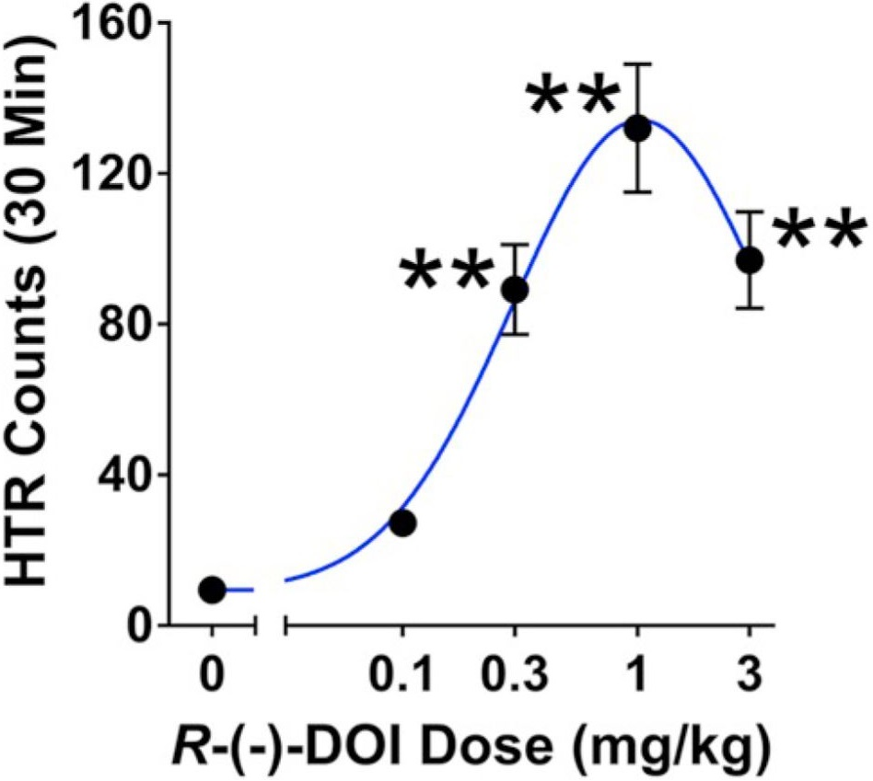
Head-twitch response
ED₅₀
half-max response
here: ~0.23mg/kg
ED₅₀

Slide 26
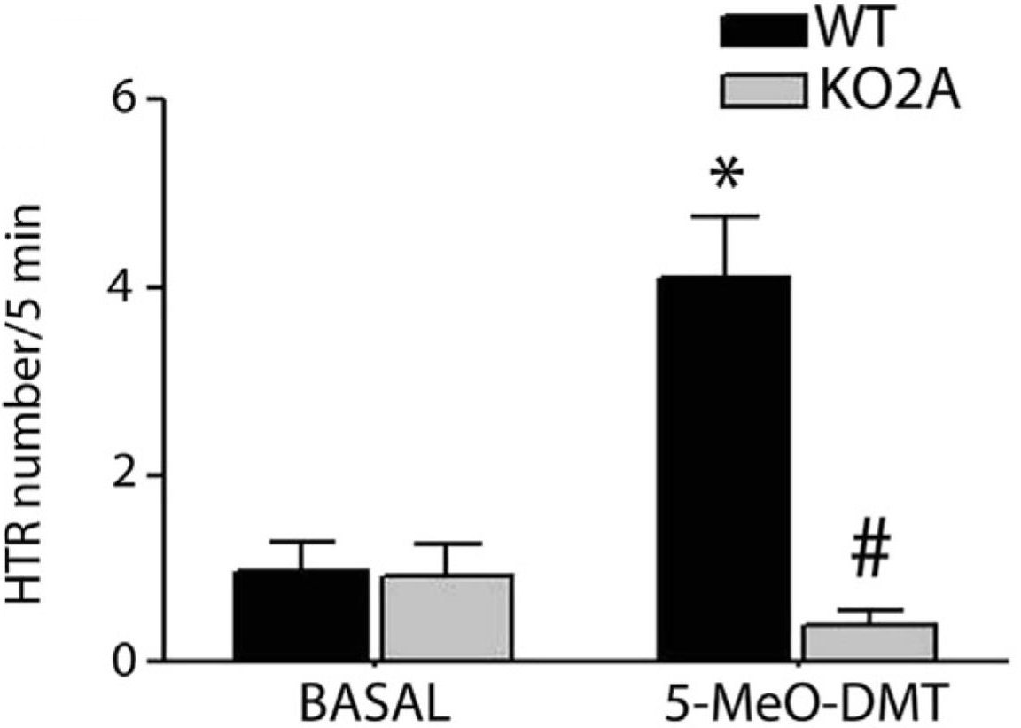
HTR is 5-HT_{2A}-mediated
5-MeO-DMT
binds 5-HT_{2A} and 5-HT_{1A}
5-HT_{2A} required for HTR
and for subjective experience?
no HTR w/o 5-HT_{2A}
Notes:
sc 5-MeO-DMT increases HTR when 2A is present (doesn’t when it’s not)
* - sign. from basal WT
# - sign. from DMT WT

Slide 27
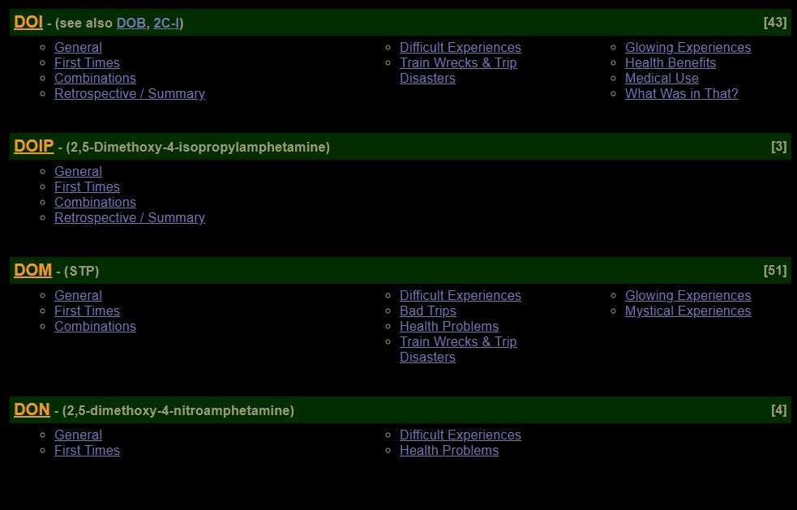
Subjective Experience and Behavior
Dose Range
similar to graphing HTR
recorded doses / experience
websites & books
Erowid
Notes:
in humans

Slide 28
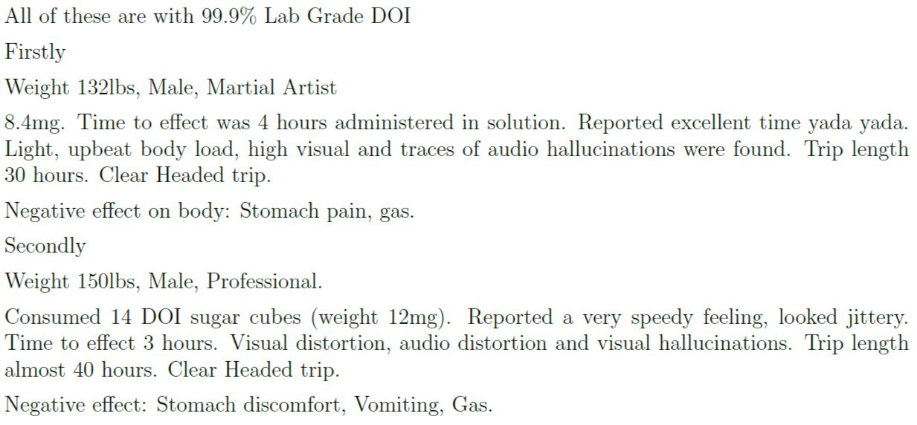
Subjective Experience & Behavior
Notes:
from Erowid

Slide 29
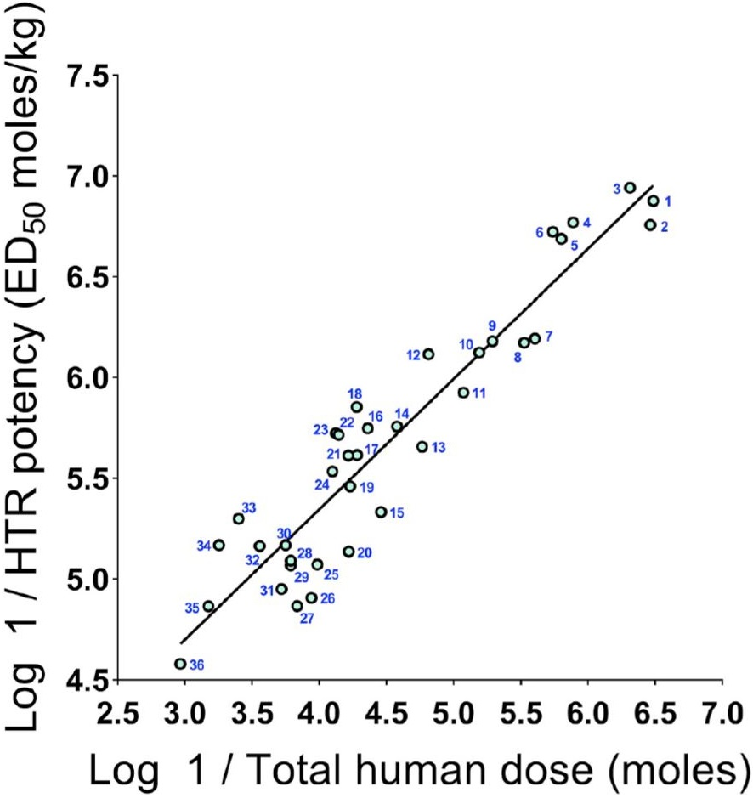
HTR & Subjective Experience
Hallucinogenic potencies
mouse & human correlation
HTR results to predict
human experience
Similar relationship
but not the same
different mechanisms?
Notes:
each number is a different psychedelic

Slide 30
Brain Activity
electrophysiology – silicon probe
local field potential (LFP)
space around neurons
firing rate (FR)
action potentials / spikes over time
electrocorticogram (ECoG) – epidural electrodes
oscillatory activity / brainwaves
activity in the low frequency range
low-frequency cortical oscillations (LFCO)
Notes:
different ways to measure brain activity
LFCO – brain activity in the low-frequency range

Slide 31
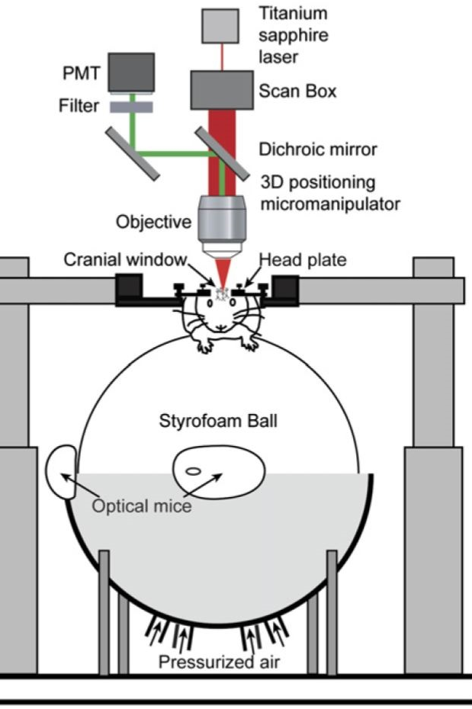
Brain Activity
widefield calcium imaging
many neurons
two-photon calcium imaging
individual neurons
change in fluorescence/fluorescence
activity differences pre-/post-drug
two-photon calcium imaging

Slide 32
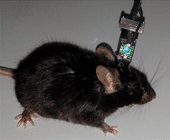
GCaMP6s mice
collecting images
calcium activity fluoresces
visualize neuronal activity

Slide 33
GCaMP6s mice
CaMKII-tTA:tetO-GCaMP6s
calcium-calmodulin-dependent kinase II
present in CaMKII-expressing neurons (excitatory)
tetracycline transactivator:tetracycline operator
controlled by tTA protein binding to tetO on DNA
genetically-encoded calcium indicator
green fluorescent protein
calmodulin
calmodulin-binding peptide M13

Slide 34
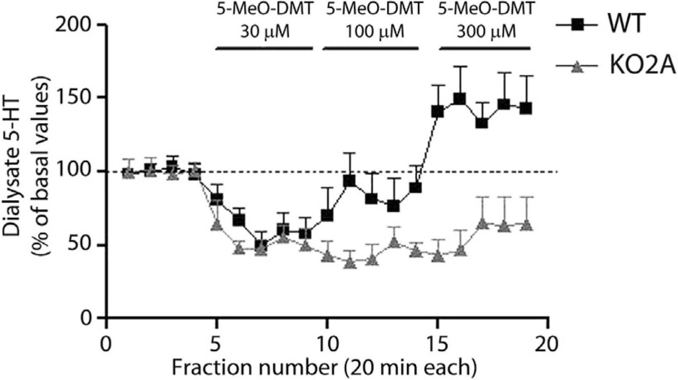
5-MeO-DMT & 5-HT concentration
mPFC
WT – typical genotype
KO2A – w/o 5-HT_{2A}
5-HT_{1A}
inhibitory – reduces [5-HT]
5-HT_{2A}
excitatory – increases [5-HT]
higher doses
5-HT_{2A} binding allows ↑[5-HT]
Notes:
mPFC – low dose: 1A autoreceptors are bound first (to 5-MeO-DMT) – decrease 5-HT release
medium dose: WT: both 1A & 2A are bound – KO2A – 1A, not 2A bound
reverse microdialysis

Slide 35
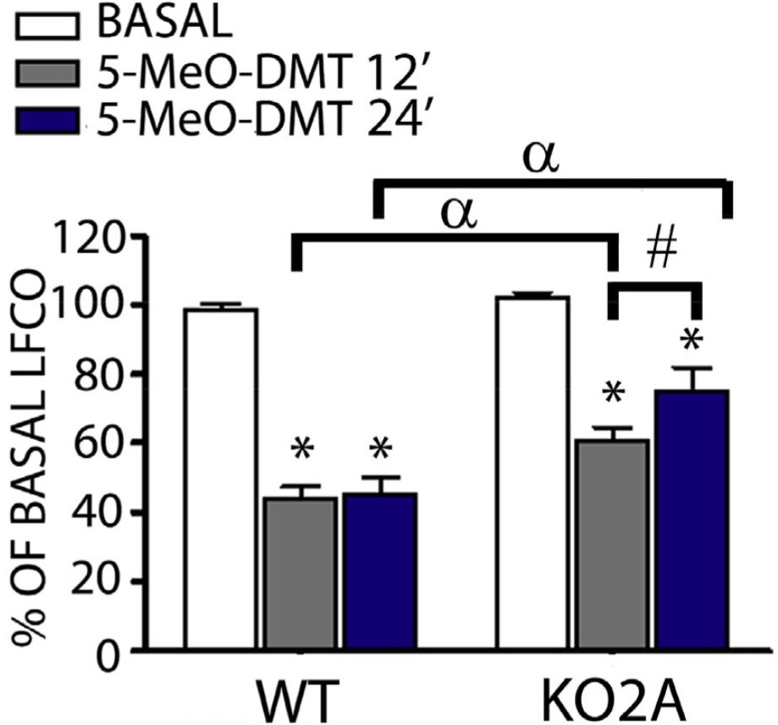
mPFC activity
5-MeO-DMT administration lowers mPFC LF activity
persists in WT after 24 min
less decrease w/o 5-HT_{2A}
and less persisting change
Notes:
sc 5-MeO-DMT
suggests 2A is part of 5-MeO-DMT’s action
* - sign. to basal

Slide 36
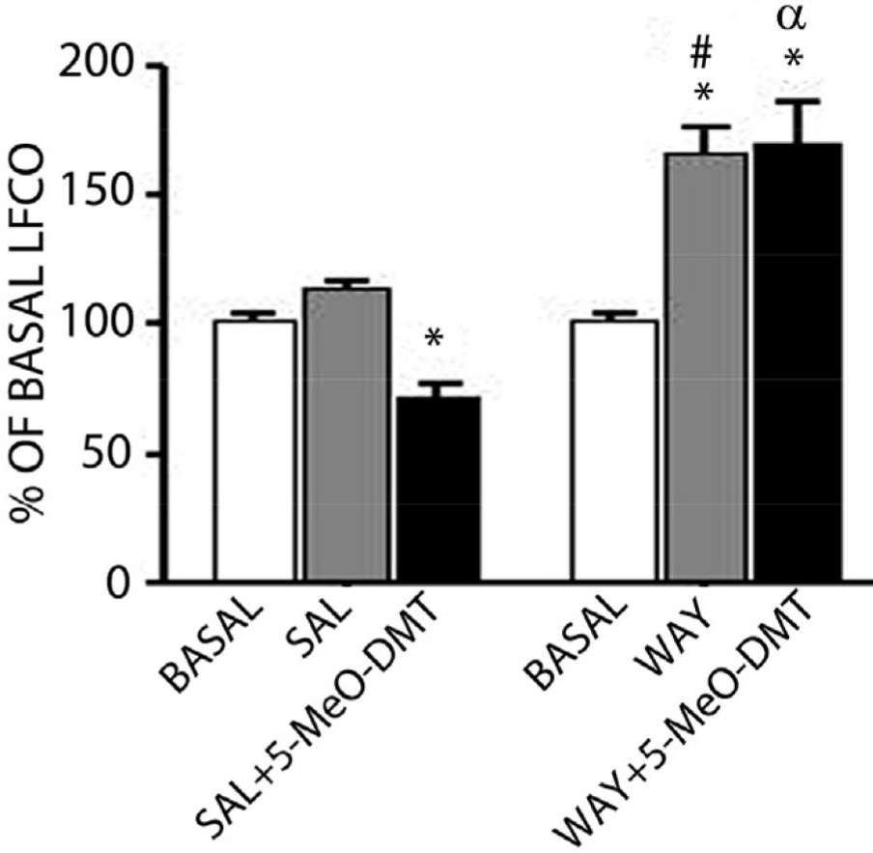
5-MeO-DMT action prevented by WAY
WAY-100635 (WAY)
5-HT_{1A} antagonist
KO2A mice, mPFC
blocking 5-HT_{1A}
disrupts balance
LF activity increases
Notes:
some kind of balance that 1A action keeps - prevents LF from increasing (too high?)

Slide 37
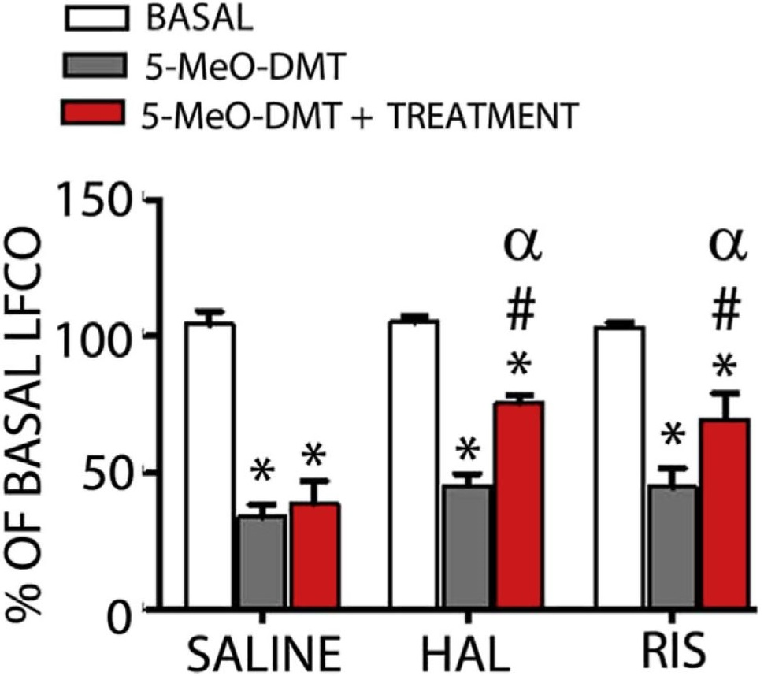
antipsychotics reverse 5-MeO-DMT action
“TREATMENT” =
saline,
haloperidol (HAL), or
risperidone (RIS)
KO2A mPFC
reduction by 5-MeO-DMT
undone by HAL & RIS
psychedelics ~ schizophrenia?
Notes:
KO2A mPFC

Slide 38
Visual Cortex
V1
Notes:
how psychedelics affect the visual system, specifically V1
maybe these effects are how hallucinations happen

Slide 39
DOI reduces V1 activity
across all layers – across wide frequency range
Notes:
visually evoked, stationary
all layers of V1
LFP by silicon probes

Slide 40
DOI affects periodic regularity
initially low
initially high
V1 neurons
overall – toward suppression
rate-specific changes
initially high FR decreased
initially low FR increased
no change in inhibitory
Notes:
stationary peak firing rate
pre-/post-DOI
saline – along the line

Slide 41
Widefield Calcium Imaging
Notes:
activity of many neurons

Slide 42
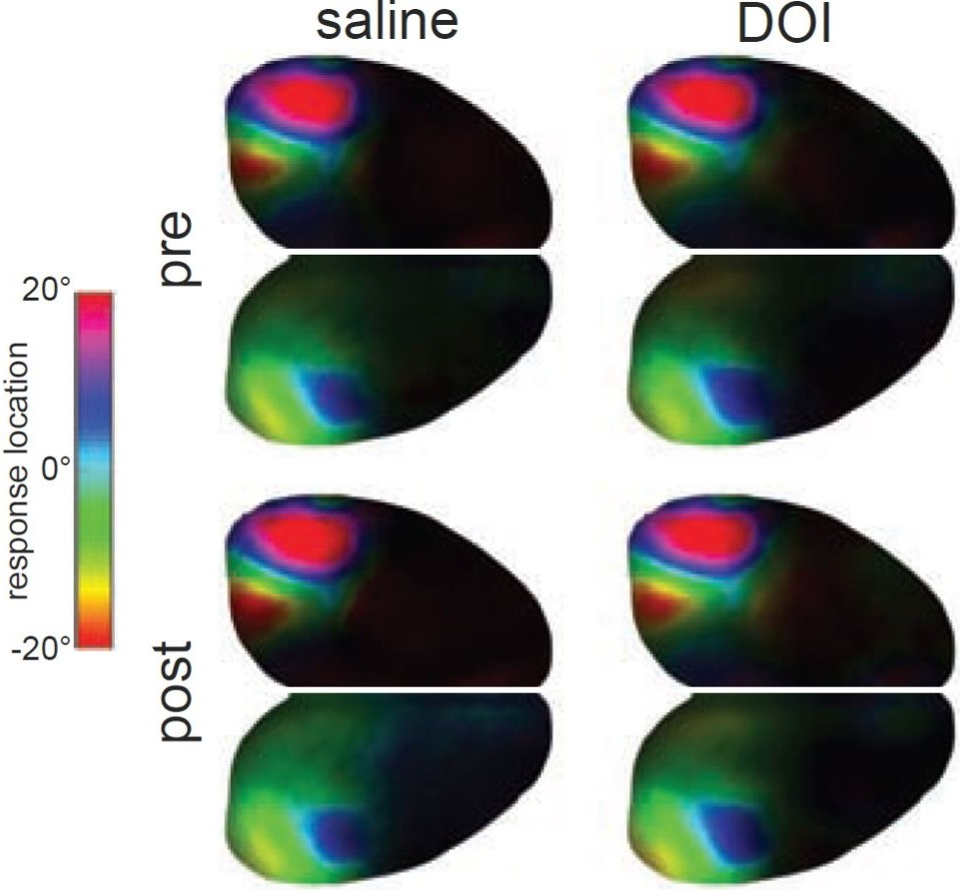
Widefield: Retinotopic Maps
Same population of cells fire
in response to the same stimuli
Notes:
no difference
scDOI or scsaline

Slide 43
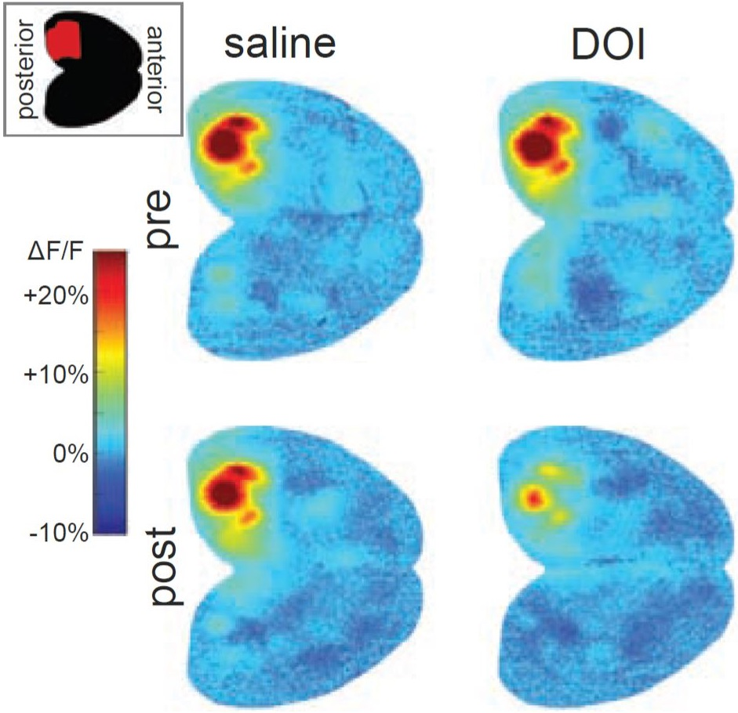
DOI causes decreased V1 activity
gray line – stimulus present
Notes:
measured by fluorescence
right eye recordings

Slide 44
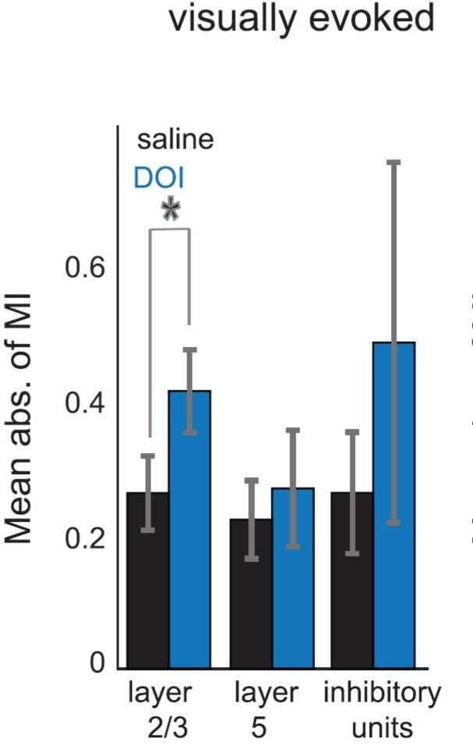
DOI affects V1 activity
L2/3 of V1 most affected
Significant change in excitatory cells’ activity
Notes:
no change in spontaneous FR
individual neuron level (two-photon)

Slide 45
Two-photon Calcium Imaging
Notes:
activity of individual neurons

Slide 46
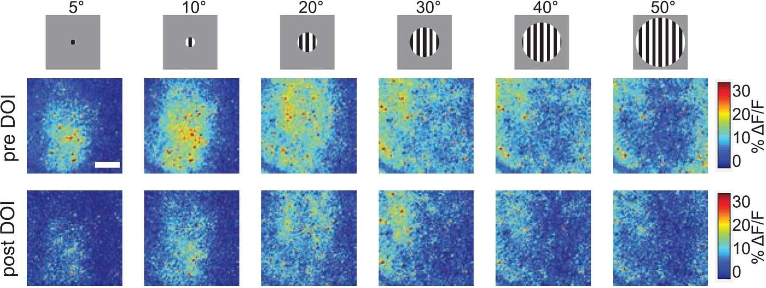
surround suppression as image gets bigger
j
Notes:
V1 L2/3 excitatory neurons
less suppression with growth because less initial activity

Slide 47
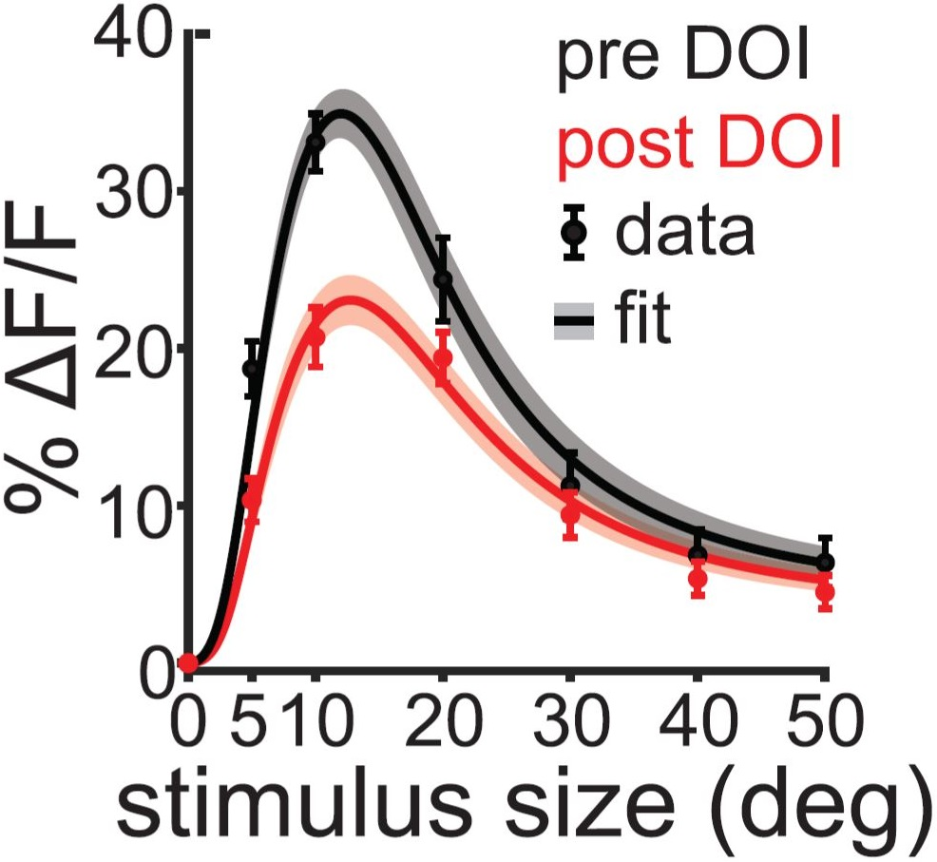
DOI reduces V1 activity
two-photon calcium imaging
excitatory neurons
Notes:
L2/3 excitatory neurons
excitatory neurons
two-photon calcium imaging

Slide 48
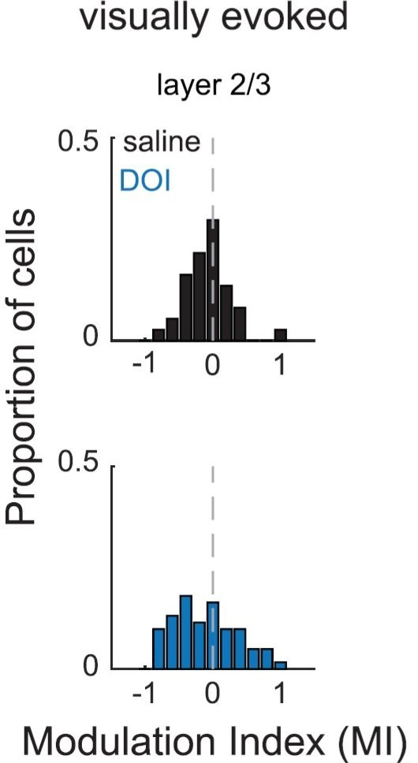
Bidirectional distribution
in L2/3
negative value – reduced FR
positive value – increased FR
Notes:
looked at just L2/3 & L5 because they “display distinct response properties”
reduced/increased . . . after DOI

Slide 49
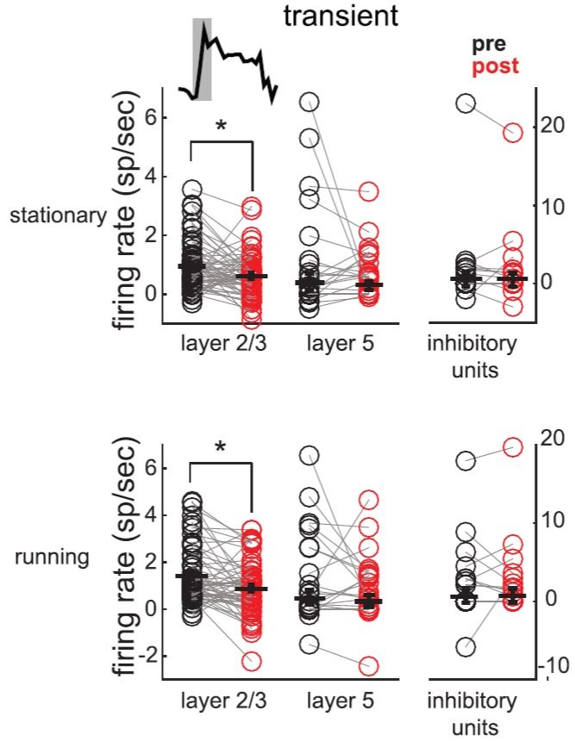
DOI decreases initial visual response
DOI alters initial temporal stage of visual stimulus response
transient – first 500ms after stimulus
reduced FR
more suppression than enhancement
Notes:
temporal dynamics

Slide 50
Au1 & V1 activity
5-MeO-DMT administration lowers brain activity
Au1 – no effect w/o 5-HT_{2A}
5-HT_{2A} required?
V1 – effect w/o 5-HT_{2A}
5-HT_{1A} is involved?
Notes:
beta – significant from Au1 DMT KO2A

Slide 51
Summarized Results
Serotonergic Psychedelics . . .
decrease activity in
mPFC (LFCO)
V1, especially L2/3 (LFCO, LFP, FR, ΔF)
Au1 (LFCO)
via 5-HT_{1A} (5-MeO-DMT)
via 5-HT_{2A} (5-MeO-DMT & DOI)
Notes:
using multiple methods to measure activity…
most pronounced change in L2/3

Slide 52
Summarized Results
HTR in mice correlates – subjective experience in humans
HTR to predict human effects
antipsychotics reverse serotonergic psychedelic effects
possible test for future schizophrenia treatments
Notes:
using multiple methods to measure activity…
most pronounced change in L2/3

Slide 53
Main Conclusions
Areas that are most effected by serotonergic psychedelics
important for hallucination formation
Decreased visual (and auditory) activity
leads to perception based more on higher-order activity
less from externally-driven systems (like V1)
Minimizing hallucinatory effects caused by psychedelics
minimize hallucinatory effects from schizophrenia
using (atypical) antipsychotics

